Slide 1
Doc-Class Demo Presentation
Harol Zhang
09/13/2019

Slide 2
The Promise of Big Data/Machine Learning/AI
Based on mathematical modelling of physical world
Uncover knowledge that works but may not be interpretable(features unexplainable)
Classification problem / Supervised learning is a close-to-mature application of above technologies

Slide 3
Requirements Gathering & Analysis
RESTful – C/S /Stateless/Cacheable/layered System/Unified interface
Respect content-type header – encoding of data payload
Discoverable from root path – Http Link Header/HATEOAS
Encoded URL with query params using HTTP GET
User Interface – framework? front end routing? element binds url?
Accuracy – a working model with acceptable prediction time
Deployment – Automation/CI/CD/Serverless/Event-Driven/high availability

Slide 4
Problem Analysis and Technology Choices
APP => SpringBoot Restful
Highest RESTful Maturity Model
Mature Framework, Developed Libraries, Minimal Code with full capabilities
Model => Notebook/SageMaker
Machine Learning Library Support
Cloud based model entry point
DevOps => Docker ECR ECS
Encapsulation/ Standardization
High Portability
Audibility and Accountability
First bullet point here
Second bullet point here
Third bullet point here

Slide 5
TFIDF -Term Frequency–Inverse Document Frequency
tfidfv = TfidfVectorizer(ngram_range=(1, 2), min_df=0.01, max_df=0.75, norm=None, tokenizer=Splitter())
App (Software Engineering)
Spring Native support for Hateoas
Model (Data Science)
Encoded text content no need to apply stop words
Deployment (DevOps)
Local notebook/ cloud based

Slide 6
Title and Content Layout with Chart

Slide 7
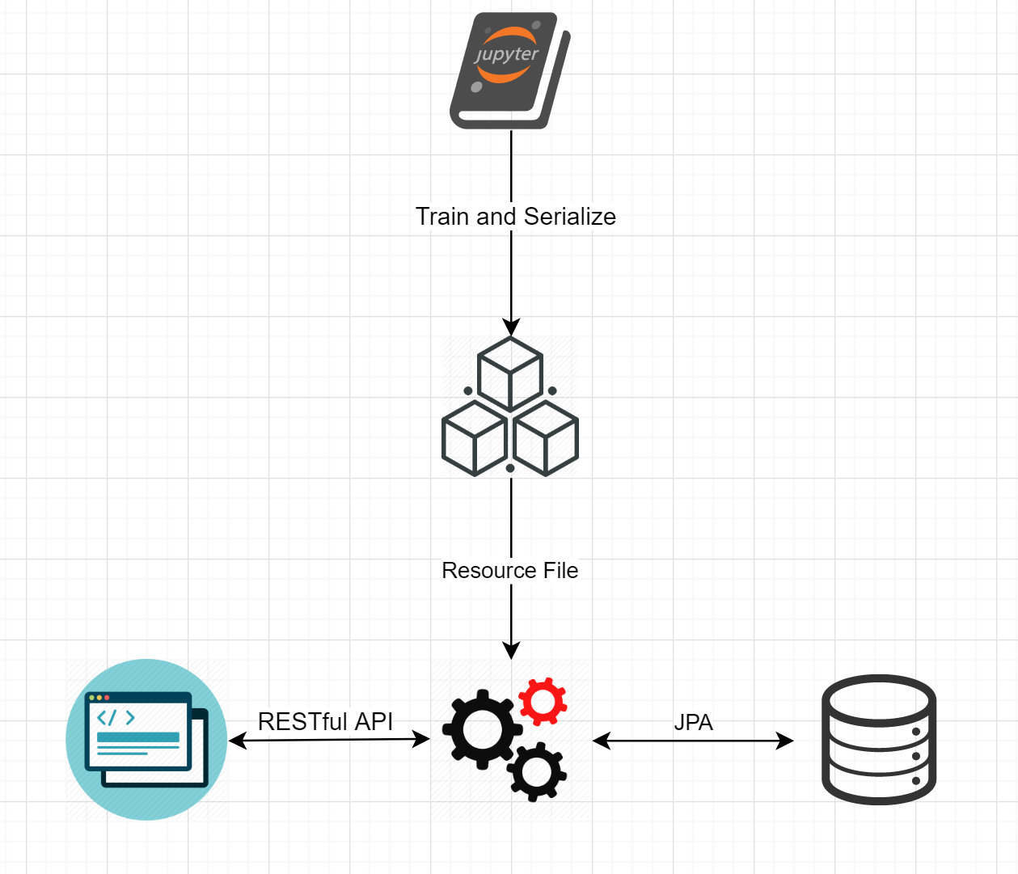
System Design Architecture
Html/JavaScript based UI/UX design utilizing one-way data binding and AJAX to restful APIs
Python/Notebook based modeling training using Scikit_learn toolkit and AWS SageMaker
Spring Boot based RESTful API Server and static web hosting
Docker based AWS container registry service and hosting service ECR and ECS

Slide 8
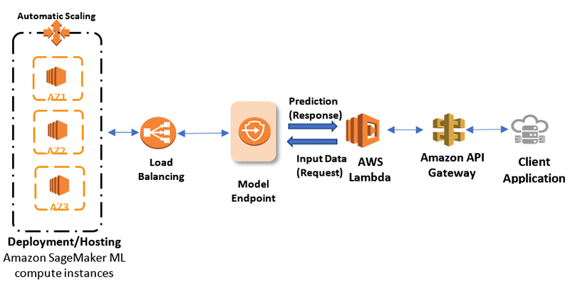
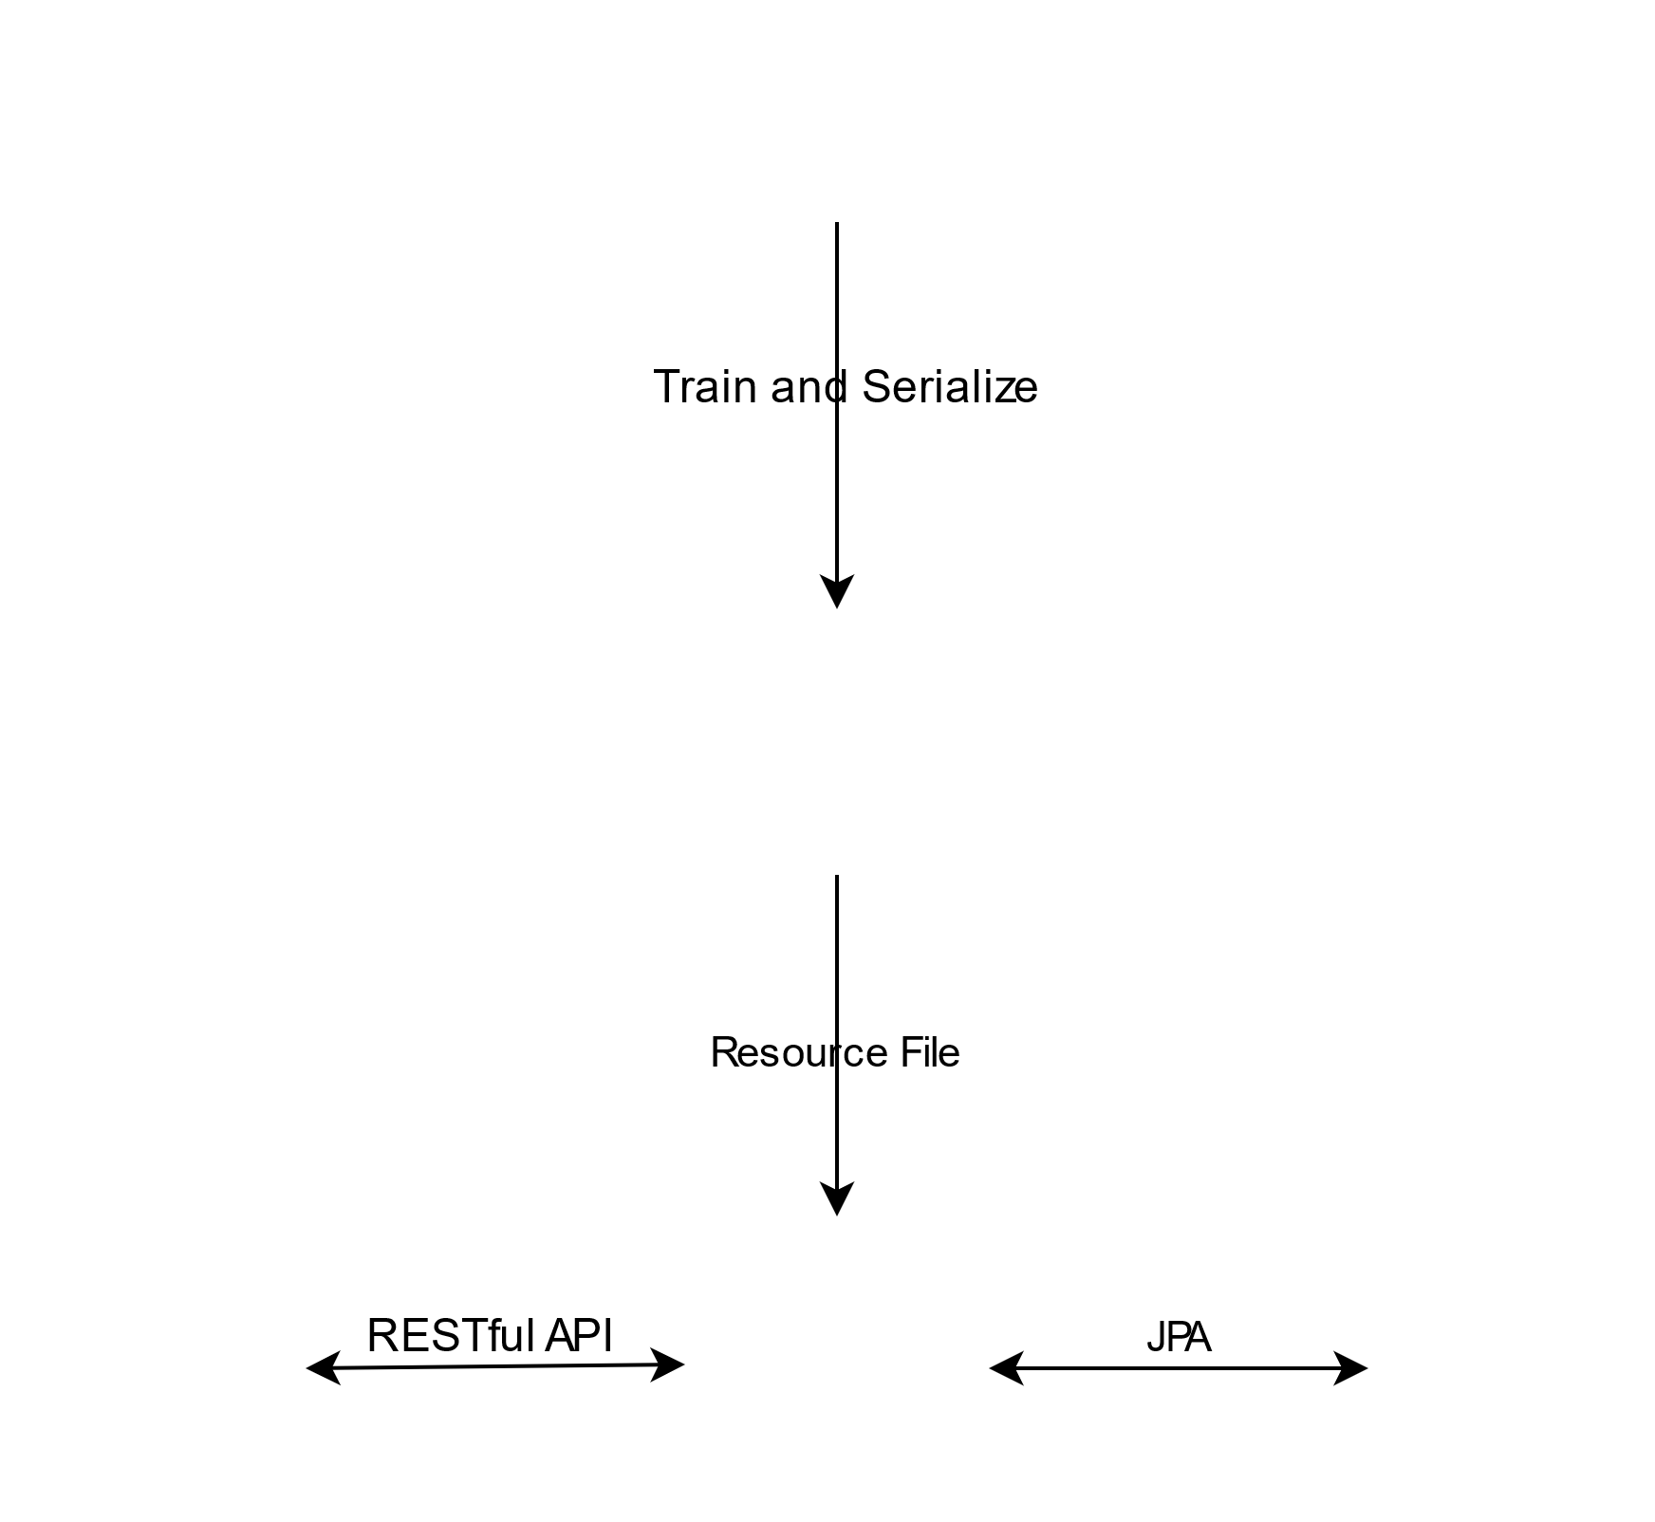
Add a Slide Title - 4

Slide 9
Two Content Layout with Table
First bullet point here
Second bullet point here
Third bullet point here
Class | Group A | Group B
Class 1 | 82 | 95
Class 2 | 76 | 88
Class 3 | 84 | 90

Slide 10
Two Content Layout with SmartArt
APP
Task 1
Task 2
Model
Task 1
Task 2
DevOps
Task 1
First bullet point here
Second bullet point here
Third bullet point here

Slide 11
Add a Slide Title - 1

Slide 12

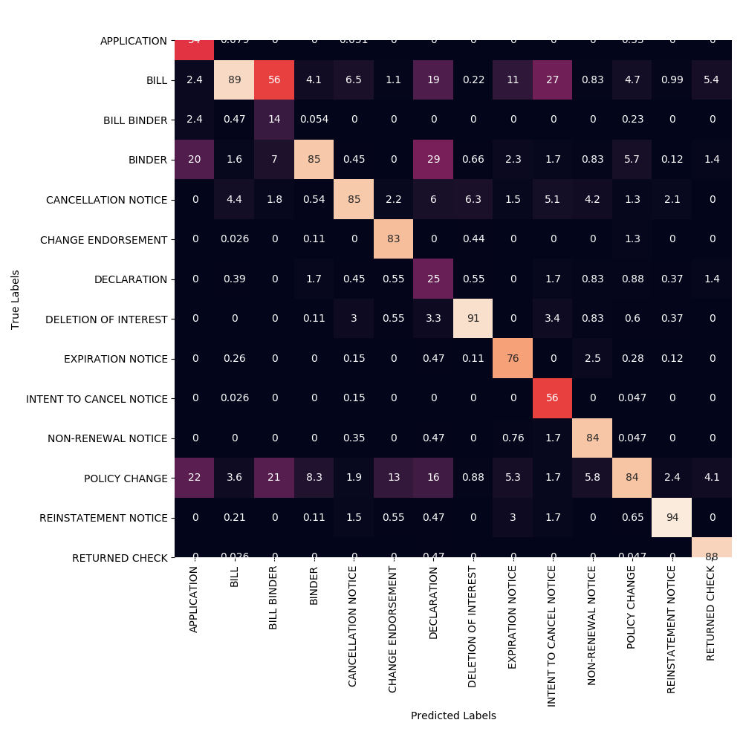
Add a Slide Title - 2

Slide 13
Add a Slide Title - 3

